Slide 1
The Baptismal Life
WELS WOMEN’s Conference
Rev Dr Michael Berg
Wisconsin Lutheran College
July 2024

Slide 2
Old Testament Imagery

Slide 3
Creation
Genesis 1 & 2 Peter 3

Slide 4
Flood
Genesis 6-10 & 1 Peter 3

Slide 5
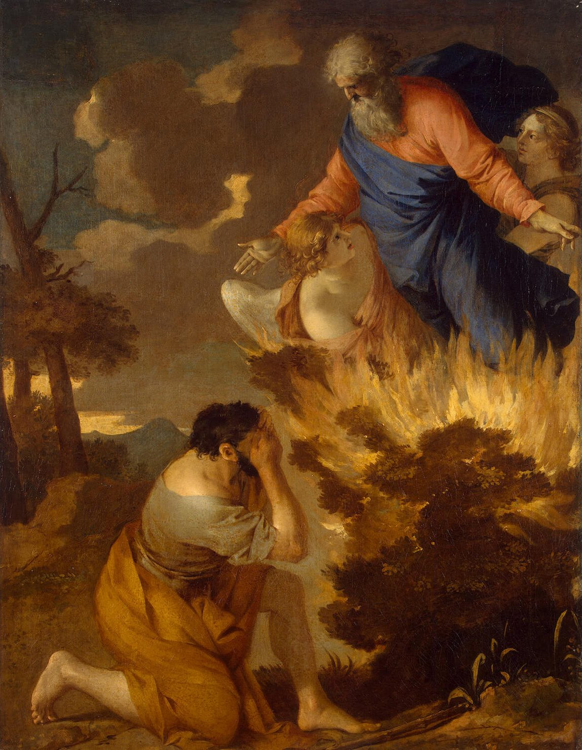
Moses
Exodus 3

Slide 6
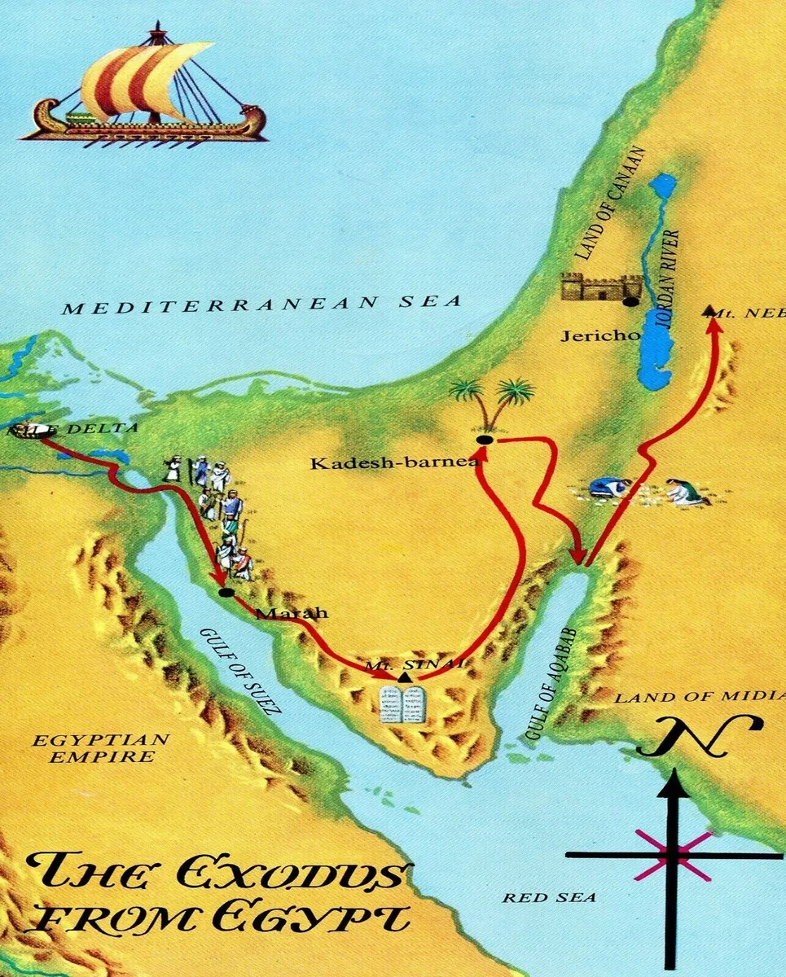
Exodus & Eisodus
Exodus 13-14 & Joshua 3-4

Slide 7
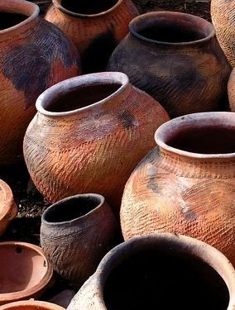
Purification Rituals
Leviticus 11-15

Slide 8
Naaman
2 Kings 5

Slide 9
New Testament Reality

Slide 10
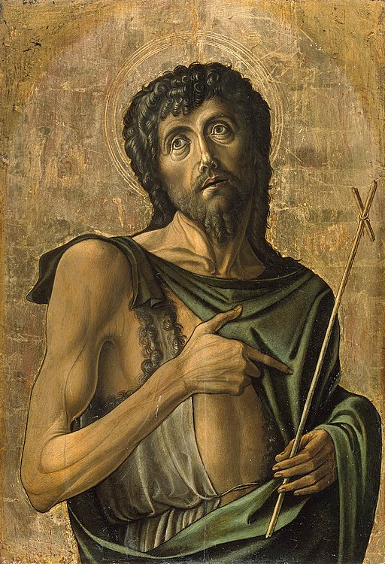
John the Baptizer
Matthew 3 & Luke 3

Slide 11
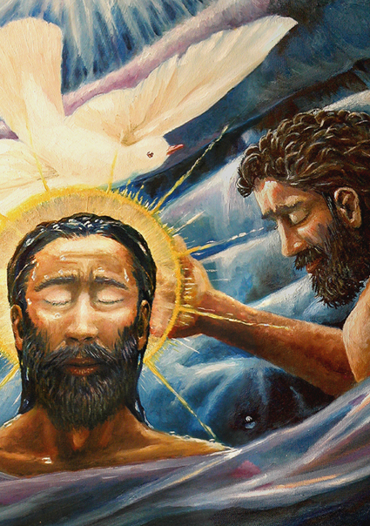
The Baptism of Our Lord
Matthew 3

Slide 12
Death & Resurrection
Romans 6

Slide 13
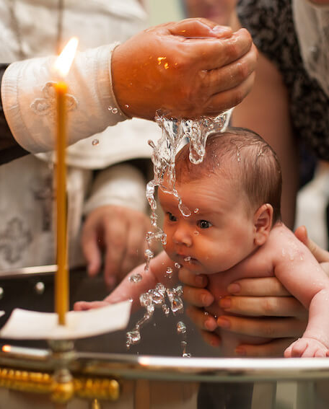
Clothing, Circumcision & Rebirth
John 3, Colossians 2-3, Galatians 3

Slide 14
All Nations
Acts 28

Slide 15
Application

Slide 16
2KR & The Simul
Romans 1, 3 & 6

Slide 17
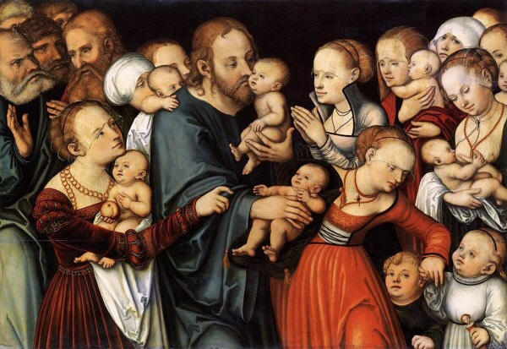
Faith, Original Sin & Infants
Psalm 51 & 82, John 3, Titus 3, Luke 1

Slide 18
Adoption & Your Baptismal Certificate
Galatians 4:4-7

